Slide 1
Back By Popular Demand!
Back By Popular Demand!

Slide 2

Calculating the Allowance for Loan and Lease Losses

Slide 3
What is the ALLL?
The Allowance for Loan and Lease Losses is a contra asset account…
Notes:
On the balance sheet that offsets the corresponding loan and lease receivables account.
***Contra asset accounts assist in the valuation of assets

Slide 4
What is its Purpose?
A valuation account that estimates the carrying value of your credit union’s loans
Notes:
ALLL is one of the most significant estimates on an institution’s financial statements and regulatory reports.
“The purpose of the ALLL is not to absorb all of the risk in the loan portfolio, but to cover probable losses that have already been incurred.”
Failure to maintain the ALLL is an unsafe and unsound practice.
_____________________________________________
http://72.3.243.42/project/loan_disclosures.shtml
In providing for losses on loans, the overriding concept in GAAP is that impairment for losses should be recognized when, based on all available information, it is probable that a loss has been incurred based on past events and conditions existing at the date of the financial statements.
A loan is impaired when, based on current information and events, it is probable that a creditor will be unable to collect all amounts due according to the contractual terms of the loan agreement. Virtual certainty of loss is not necessary to be probable; however, the amount of the loss must be reasonably estimable.
Losses are not recognized before it is probable that they have been incurred, even though it may be probable based on past experience that losses will be incurred in the future.

Slide 5
Balance Sheet Presentation
The ALLL is a “contra-asset” account on the asset side of the balance sheet.
CREDITS increase the account
    Recoveries on charged off loans
    Provision for Loan and Lease Losses Expense
DEBITS decrease the account
                Charge offs
CREDIT UNION |  | BALANCE SHEET 12/31/2009
Assets |  | Liabilities & Equity
Loans $2,000,000 |  | Accts Pay. $10,000
Less: ALLL -$28,000 |  | Total Liabilities $10,000
Net loans $1,972,000
Notes:
Contra Account – also called a valuation account is an asset account that offsets an associated account. For example, accumulated depreciation account that reduces the original cost of an asset to arrive at its book value.
The ALLL has a credit balance. Recoveries from charged off loans and PLLL expense entries increase the account balance. Entries to record Charged Off Loans decrease the account balance.

Slide 6
NCUA’s Accounting Bulletin 06-01, Letter to Credit Unions 03-01 & IRPS 02-3
Guidance for the ALLL:
  FAS 114 and FAS 5 apply to all credit unions regardless of size.
FAS 114 will generally be limited to Troubled Debt Restructurings (TDRs) for smaller credit unions.
Incorporates Generally Accepted Accounting Principles through:
FAS 114 - covers large, non-homogeneous loans and Troubled Debt Restructured loans
FAS # 5 covers – The Pooling method – small homogeneous loan pools
Notes:
The
As our audience is small credit unions under $20 million we will concentrate on FAS 5 and generally limit our discussion of FAS 114 to TDR’s.
Troubled Debt Restructuring - Distinguish (upfront) between the concepts of “restructuring debt” and a “troubled debt restructuring”, the latter concept having a specific significance within GAAP.
According to FAS 15, a restructuring of a debt constitutes a troubled debt restructuring if the financial institution for economic or legal reasons related to the borrower’s financial difficulties grants a concession to the borrower that it would not otherwise consider. That concession either stems from an agreement between the financial institution and the borrower or is imposed by law or a court. A troubled debt restructuring may include, but is not necessarily limited to, one or a combination of the following:
• Transfer from the borrower to the financial institution of receivables from third parties, real estate, or other assets to satisfy fully or partially a debt.
• Issuance or other granting of an equity interest to the financial institution by the borrower to satisfy fully or partially a debt unless the equity interest is granted pursuant to existing terms for converting the debt into an equity interest.
• Modification of terms of a debt, such as reduction of the stated interest rate for the remaining original life of the debt.
It is important to note that not all debt restructuring qualifies as TDR, even if the member debtor is experiencing some financial difficulties. A TDR is not involved if the:
a) Fair value of the property received (by repossession or foreclosure) at least equals the credit union’s recorded investment in the loan (face amount +/- applicable accrued interest and unamortized premium, discount, finance charges, or acquisition costs but not net of ALLL); or
b) Credit union reduces the effective interest rate on the loan primarily to reflect a decrease in market interest rates in general or a decrease in the risk so as to maintain a relationship with a borrower who can readily obtain funds from other sources at the current market interest rate.
Each SFAS Nos. 15, 114, and 144 must be taken into consideration when accounting for TDR.

Slide 7
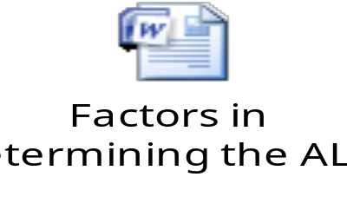
Factors In Determining ALLL
Lending policies and procedures
Underwriting standards
Nature and volume of asset portfolio
Experience and ability of the lending staff
Overall quality of loan portfolio
Quality of loan review system
Degree of oversight by the Board
Amount of credit concentrations, economic & business conditions for the credit union
Notes:
Stop the presentation and go to the handout: “Factors in Determining the ALLL”
Click on the embedded WORD document to access the handout
Ask the audience for comment on these points:
Changes in lending policies and procedures:
Has the credit union changed the way it makes loan decisions? (shorter loan form, etc.)
Has the credit union introduced a new loan product?
Has the credit union streamlined its decision criteria?
Underwriting standards:
Is the credit union relaxing its lending guidelines to serve more of its members?
Has the credit union adopted a new scoring system? (changed from FICO to another system)
Nature and volume of asset portfolio:
Is the credit union in a new loan campaign?
Is the credit union emphasizing a new/used car promotion (Enterprise sales)
Experience and ability of lending staff:
Have new loan personnel been hired recently?
What has been the individual charge off rate for each of the lending staff?
Overall quality of loan portfolio:
Have charge offs been historically high?
Have charge off been escalating recently?
Quality of loan review system:
Do marginal loans get reviewed by a credit committee or a second set of eyes?
Are charge offs given a “post mortem” exam?
Degree of oversight by the Board:
Does the Board understand its responsibility in management oversight?
Does the Board get regular training in regulatory matters and Board responsibilities?
Amount of credit concentrations, economic & business conditions of the credit union?
Do one or two credit products dominate the loan portfolio?
Any major SEG laying-off or going out of business?
Have market conditions negatively impacted the credit union’s bottom line?

Slide 8
FAS 5 – Pooling Method
FAS 5 component of ALLL consists of:
Losses that are probable
The loss can be estimated
Notes:
The FAS 5 component of the ALLL consist of all losses that are probable (that result from an event that can be identified and that has already happened, not an event that is rumored to happen sometime in the future) and that can be estimated.

Slide 9
FAS 5 - Pooling Method
To comply with FAS 5:
  Group loans by type, delinquency status, credit risk, category, purpose, etc.
  Develop historical loss factor for each pool. Adjust loss factor for relevant external factors
Step 1
  Apply adjusted loss factors to respective loan pools
Step 2
Step 3
Notes:
For small credit unions, groups of loans may include:
Signature loans
Credit card loans
New vehicle loans
Used vehicle loans
HELOCs
***NOTE: it is insufficient to group loans solely by loan type to the exclusion of delinquency status. Doing so will inevitably create an underfunded ALLL***

Slide 10

What’s your Methodology?
What are some ways to incorporate STEP #1?
Notes:
Accounting Bulletin 06-01, “Factors to Consider in Estimation of Credit Losses,” pg 8:
“While historical loss experience provides a reasonable starting point for the institution’s analysis, historical losses, or even recent trends in losses, do not by themselves form a sufficient basis to determine the appropriate level for the ALLL. Management should also consider those qualitative or environmental factors that are likely to cause estimated credit losses associated with the institution’s existing portfolio to differ from historical loss experience”

Slide 11
Step 1
Pool (group) loans by type, delinquency status, credit risk, category, purpose, etc.
Notes:
Documentation helpful in pooling loans: Loan trial balances by categories, delinquency stage and types of loans, Management reports about the mix of loans in the portfolio, An internal or external loan grading report, call report.
For loans evaluated on a group basis under FAS 5, management should pool the loan portfolio by identifying risk characteristics that are common to groups of loans. Credit unions typically decide how to pool their loan portfolios based on many factors, which vary with their business strategies as well as their information system capabilities.
Smaller credit unions that are involved in less complex activities often pool the portfolio into broad loan categories. This method of segmenting the portfolio is likely to be appropriate only in small credit unions offering a narrow range of loan products.
Larger credit unions typically offer a more diverse and complex mix of loan products. Such credit unions may start by pooling the portfolio into major loan types but typically have more detailed information available that allows them to further segregate the portfolio into product line segments based on the risk characteristics of each portfolio segment. (i.e.: purpose or collateral code)
Regardless of the segmentation method used, a credit union should maintain documentation to support its conclusion that the loans in each segment have similar attributes or characteristics.
As economic and other business conditions change, credit unions often modify their business strategies, which may result in adjustments to the way in which they pool their loan portfolio for purposes of estimating loan losses.

Slide 12
Step 2
DEVELOP a historical loss factor for each pool.
Adjust for relevant external factors
Notes:
***The starting point to developing accurate historical loss factors involves a consistently applied and timely charge-off policy***
(See NCUA’s Letter to Credit Unions 03-01)
The Accounting Bulletin 06-01 states, on page 6, that ALLL policies and procedures should ensure that: “The institution promptly charges off loans, or portions of loans, that available information confirms to be uncollectible.”
Next, management should consider those qualitative or environmental factors that are likely to cause estimated credit losses associated with the credit union’s existing portfolio to differ from the historical loss experience, such as:
External changes in international, national, regional, and local economic and business conditions (foreclosures, layoffs…)
Developments affecting collectability of the portfolio including the condition of various market segments (slow down of new home sales, BK of servicer)
Credit loss and recovery experience may vary significantly depending upon the stage of the business cycle. For example, an over reliance on credit loss experience during a period of economic growth will not result in realistic estimates of credit losses during a period of economic downturn.
Effect of other external factors on the level of estimated credit losses in the portfolio - competition, legal requirements, regulatory requirements
Credit unions typically reflect the overall effect of these factors on a loan group as an adjustment that, as appropriate, increases or decreases the historical loss rate applied to the loan group. Alternatively, the effect of these factors may be reflected through separate standalone adjustments within the FAS 5 component of the ALLL.
The adjustments for qualitative or environmental factors must be reasonably and consistently determined, adequately documented, and represent estimated credit losses. For each pool of loans, a credit union should apply its adjusted historical loss rate, or its historical loss rate and separate standalone adjustments, to the recorded investment in the group when determining its estimated credit losses.
If a new CU or product, consider utilizing a “peer” loss ratio - - NCUA and FDIC websites, unemployment rates in the local market, etc. For example, the CU can create a custom FPR - - using NCUA’s website or ask EX/EDS to create a custom FPR.

Slide 13
Step 3
Apply adjusted loss factor to individual loan pools
Notes:
Apply adjusted loss factors to loan pools
This described methodology is “one” way that a credit union can apply the supervisory guidance issued in the IRPS 02-3

Slide 14
FAS 5 - Recap
QUESTIONS?
1. Pool loans by type and delinquency status at a minimum
2. Calculate a loss factor for each pool and adjust for relevant external factors
3. Apply adjusted loss factor individually to each loan pool
Notes:
***Emphasize – this is only one method to develop the ALLL calculation; credit unions should follow supervisory guidance in IRPS 02-3 in developing their ALLL methodology***

Slide 15
FAS #5 Methodology Must Be In Writing!
Notes:
STOP PRESENTATION- Discuss these points from the IRPS 02-3:
Describe FAS 5 ALLL methodology in writing, to include :
How loans with similar characteristics are grouped to be evaluated for loan collectibility (such as loan type, past-due status, and risk)
How loss rates are determined (e.g. historical loss rates adjusted for environmental factors or migration analysis) and what factors are considered when establishing appropriate time frames over which to evaluate loss experience
Descriptions of qualitative factors (e.g., industry, geographical, economic and political factors) that may affect loss rates or other loss measurements

Slide 16
FAS 114 – Individual Impairment
Covers large, non-homogeneous loans like:
This analysis is separate and distinct from the FAS #5 pooling analysis
Unique business loans (material credit exposure)
Large business loans
Large agricultural loans
Troubled Debt Restructured Loans
Notes:
FAS 114 applies to small credit unions most often in the case of troubled debt restructurings (TDRs).
A TDR is one in which the creditor allows the debtor certain concessions that would not be considered in the normal course of business. These are made in light of the debtor’s financial difficulty, with the objective of the creditor to maximize recovery.
Identifying loans to be evaluated for impairment:
A loan is impaired when based on current information, events or management’s judgment, it is probable that the credit union will be unable to collect all amounts due (principal and interest) according to the contractual terms.

Slide 17
FAS 114 – Individual Impairment
Three acceptable means of measurement:
Present Value of expected future cash flows discounted at the loan’s effective interest rate
Fair Value of collateral (for collateral dependent loans)
Market Value of collateral (observable)
Notes:
FAS 114 applies to small credit unions most often in the case of troubled debt restructurings (TDRs).
A TDR is one in which the creditor allows the debtor certain concessions that would not be considered in the normal course of business. These are made in light of the debtor’s financial difficulty, with the objective of the creditor to maximize recovery.
Identifying loans to be evaluated for impairment:
A loan is impaired when based on current information, events or management’s judgment, it is probable that the credit union will be unable to collect all amounts due (principal and interest) according to the contractual terms.

Slide 18
Items for Consideration
Other factors as appropriate for the loan type.
Confidence in the credit union’s lien or security position
Historical losses on similar loans;
Date of the inspection of the collateral;
Reliability and date of the appraisal or other valuation;
Volatility of the market value of the collateral;
Notes:
These items are not considered solely for impaired loans covered by FAS #114. These same considerations are applicable to FAS #5 pooling methodology as well.

Slide 19
What are TDRs?
Troubled Debt Restructurings

Slide 20
Two Types of TDRs
Debt settled at less than carrying value
Modification of debt terms
Notes:
Debt settled at less than carrying value:
Reduction of the face amount or maturity amount of the debt as stated in the loan agreement
Transfer from the member to the credit union real estate or other assets to partially satisfy a debt (e.g.: repossession, short sale, foreclosure)
Modification of debt Terms:
Reduction of stated interest rate for remaining life of the loan
Extension of the maturity date or dates at a stated interest rate lower than the current market rate for new debt with similar risk
Reduction of accrued interest

Slide 21
A TDR is NOT the following:
Fair value of the property received equals at least the credit union’s recorded investment in the loan
Interest rate reduction based on competition
Short term extension
Notes:
Fair value:
Fair value of the property received (by repossession or foreclosure) at least equals the
credit union’s recorded investment in the loan (face amount +/- applicable accrued
interest and unamortized premium, discount, finance charges, or acquisition costs but not
net of ALLL)
Interest rate reduction:
Credit union reduces the effective interest rate on the loan primarily to reflect a decrease
in market interest rates in general or a decrease in the risk so as to maintain a relationship
with a borrower who can readily obtain funds from other sources at the current market
interest rate.
Short term extension:
Extensions offered as a promotion (e.g. “Skip a pay”), or short term extensions for temporary financial hardship (less than 90 days). No financial concessions are made by the credit union due to hardship.

Slide 22
FAS 114 – Individual Impairment Example
Individually Impaired Loans
Acct Name Loan type Balance | Notes |  | Impairment
4733 – F. Astaire Travel Trailer $65,000 | TDR – member Bankrupt - $45,000 appraisal and $3,000 costs of sale, restructured loan per court order and reduced balance to $45,000 |  | $23,000
7890 – T. Smith Real Estate $70,000 | TDR – member unemployed for 14 months – $60,000 appraisal and $7,600 costs of sale and $2,400 repairs (reduced rate to below market) |  | $20,000
Total Individually Impaired $135,000 |  |  | $43,000
Notes:
If the credit union is depending upon an income stream for repayment purposes, then the impairment must be determined using present value calculations on future cash flows.
If the credit union is depending on the sale of the collateral to determine impairment, then use the collateral value less cost to sell

Slide 23
You Call It!

Slide 24
Is it or Isn’t it a TDR?
John Member has asked for a one month extension because he had some unexpected expenses. Credit union grants one month extension.
The credit union regularly grants extensions.
Notes:
No, this is not an example of a TDR because credit unions frequently offer one month extensions to all members of their organization whether as a promotion or for short-term delinquencies.

Slide 25
Is it or Isn’t it a TDR?
Mary C. has two loans with the credit union.
She is having trouble making both payments so the credit union is refinancing the two loans into one, thus reducing Mary C.’s payment.
The interest rate granted is a market rate.
Notes:
No, this is not a TDR. No concessions are made by the credit union because there has not been a loss of principal or interest in the refinance. This is a normal course of business transaction.
The interest rate given is a market rate

Slide 26
Is it or Isn’t it a TDR?
Joe M. is four months behind on his HELOC. Joe informs the credit union that he is unemployed with no additional income.
The credit union allows Joe to pay six months interest only payments under a short-term plan
The credit union also agrees to waive all of the accrued interest to-date on the loan. The interest amounts to $3,277.45
Notes:
Yes TDR – credit union makes concession it normally would not have to assist member. The credit union would have to include any write down of interest on it’s ALLL analysis and carry the loan at its original terms and delinquent status on the 5300 report for six months.

Slide 27
Is it or Isn’t it a TDR?
Fred S. is consistently two months late on his auto payments for a 2008 Saturn due to his business faltering over the past year.
Since the auto is no longer manufactured and Fred’s income is reduced, he wants to give the vehicle back to the credit union.
Fred S. owes the credit union $13,233 and the same year Saturn has an auction wholesale value of $8,500.
The credit union agrees to lower Fred’s interest rate from 5.90% to 1.90%, write down the loan to its current market value of $ 11,700 and reduce his monthly payments.
Notes:
Yes, this is a TDR because the credit union makes concessions that it ordinarily would not make to help the member who is in financial distress. The credit union would have to include the write down (interest and principal) on it’s ALLL and carry the loan at its original delinquent terms on the 5300 report for 6 consecutive months.

Slide 28
FAS 114 - Recap
TDRs must be assessed under FAS 114.
Reminder!!! – an impaired loan under an FAS 114 analysis is not included in the FAS 5 analysis.
Document the analysis and don’t double count.
Notes:
Additional teaching point: A TDR evaluated under FAS 114 and found not to be impaired should be reevaluated under FAS 5. A TDR evaluated under FAS 114 and found to have impairment measured at zero should not be reevaluated under FAS 5.
FAS 114 Evaluation Process: FAS 114 does not establish specific criteria about which loans should be subject to individual review;
Loans that represent significant concentrations of credit, material non-performing loans, insider loans and other material credit exposures should be subject to impairment analysis.
Measure Impairment Amount: The estimated impairment should reflect consideration of one of the three standards of measurement (discussed below). If no, loans should be grouped with others loans with common characteristics and subject to evaluation under FAS 5.
Based on one of three methods:
Present Value of the expected future cash flows, discounted at the loan’s effective interest rate.
Fair Value of the Collateral, less costs to sell (Required as soon as the credit becomes Collateral Dependent.)
Observable Market Price (not customarily available for loans).
The effective interest rate on a loan is the rate implicit in the loan (e.g., the contractual interest rate adjusted for any net deferred loan fees and cost, and any premium or discount existing at the origination or acquisition of the loan.
Under FAS 15, a restructuring of debt constitutes a Troubled Debt Restructuring (TDR) if a creditor for economic or legal reasons related to the debtor’s financial difficulties grants a concession to the debtor it would not otherwise consider. A TDR involves a transfer from the borrower to the bank (including via foreclosure or repossession) of real estate, receivables from third parties, other assets, or an equity interest in the borrower in full or partial satisfaction of the loan; modification of the loan terms; or a combination of the two. In a TDR, a loan is considered impaired and FAS 114 must be applied, even if a loan would not otherwise fall within the scope of FAS 114 because it would otherwise be part of a large group of smaller-balance homogeneous loans that are collectively evaluated for impairment. For example, FAS 114 applies to TDRs of 1-4 family residential mortgage loans that may have been previously evaluated in a larger pool under FAS 5.
Procedures should prevent “layering” or “double counting”; Get away from using the term “individually classifying” use the term “individually impaired”;DOCUMENT EVERYTHING.

Slide 29
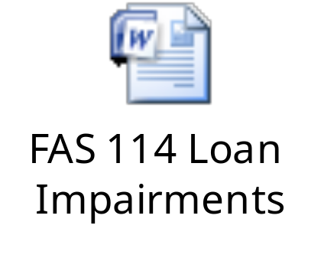
Practice Sets for FAS 114
Notes:
Click on the embedded WORD document for “Practice Sets for FAS 114”
And select “Open Hyperlink” to access the problem sets for the audience. Don’t show the answer sheet while the audience is working on the problem sets. Allow audience to work on problem sets as individual tables. Have NCUA staff work with audience before going to answers.

Slide 30
Elements of the ALLL
Your ALLL analysis must include FAS 5 and FAS 114 elements
External Factors
(FAS 5)
Individual Impairment
(FAS 114)
Required Allowance
Pooling/Historical Factor
(FAS 5)
Notes:
Review with audience the above elements for clarity. If necessary, use sheet, “Factors in Determining the ALLL” to review elements for consideration from slide #7.
These are the only elements of a properly funded ALLL - it is no longer acceptable to add a cushion to the ALLL.

Slide 31
Adjusting the ALLL
If summary report shows ALLL is underfunded increase the balance to the appropriate amount by:
Debit – Provision for Loan and Lease Losses EXPENSE
Credit – Allowance for Loan and Lease Losses
If summary report shows the ALLL is overfunded decrease the balance to the appropriate amount by:
Debit – Allowance for Loan and Lease Losses
Credit – Provision for Loan and Lease Losses EXPENSE
Notes:
The point is that you increase and decrease the ALLL based on your analyses…

Slide 32
Validating ALLL Methodology
Establish procedures to re-evaluate & periodically test the appropriateness of your methodology.
Review by a party independent of ALLL estimation process (e.g. Supervisory Committee, auditor).
As long as your methodology is reasonable, defensible, and documented, it should be acceptable.
Include a “look back” to see if estimates were subsequently confirmed or if necessity exists to adjust estimates accordingly.
Notes:
Exs will perform an assessment of the appropriateness of the level of the allowance account and the process used to calculate the ALLL estimate used in the institution’s regulatory reports.
An ALLL methodology is a system that a credit union designs and implements to reasonably estimate loan and lease losses as of the financial statement date. It is critical that ALLL methodologies incorporate management’s current judgments about the credit quality of the loan portfolio through a disciplined and consistently applied process.
A credit union’s ALLL methodology is influenced by credit union-specific factors, such as a credit union’s size, organizational structure, business environment and strategy, management style, loan portfolio characteristics, loan administration procedures, and management information systems.
In practice, credit unions should employ numerous procedures when validating the reasonableness of their ALLL methodology and determining whether deficiencies exist in their overall methodology or loan grading process.
Validation procedures include the following:
A review of trends in loan volume, delinquencies, restructurings, and concentrations;
A review of previous charge-off and recovery history, including an evaluation of the timeliness of the entries to record both the charge-offs and the recoveries;
A review (on a test basis by a party independent of the ALLL estimation process) of source documents and underlying assumptions to determine that the established methodology results in reasonable loss estimates; and
An evaluation of the appraisal process of the underlying collateral, by periodically comparing the appraised value to the actual sales price on selected properties sold.

Slide 33
What is the Responsibility of the Board in Maintaining the ALLL?
Ensure controls are in place
Instruct management to develop a process
Ensure that all related policies specifically address the credit union’s unique goals
Review the amount of periodic ALLL and PLLL adjustments
Validate Methodology
Notes:
Boards of directors of federally-insured credit unions are responsible for ensuring that their credit unions have controls in place to consistently determine the adequacy of the ALLL in accordance with the credit union’s stated policies and procedures, GAAP, and ALLL supervisory guidance.
To fulfill this responsibility, boards of directors instruct management to develop and maintain an appropriate, systematic, and consistently applied process to determine the amounts of the ALLL and provisions for loan losses.
Management should create and implement suitable policies and procedures to communicate the ALLL process internally to all applicable personnel.
Regardless of who develops and implements these policies, procedures, and the underlying controls, the board of directors should assure themselves that the policies specifically address the credit union’s unique goals, systems, risk profile, personnel, and other resources before approving them.
Additionally, by creating an environment that encourages personnel to follow these policies and procedures, management improves procedural discipline and compliance.

Slide 34

Policies and Procedures
Roles & Responsibilities
Accounting policies
Description of methodology
Documentation requirements
Internal control system
Well defined loan review process
Notes:
After reviewing this slide, click on the WORD document “Factors in Determining the ALLL” to access the guide for drafting an appropriate ALLL and policies and procedures.
The ALLL process requires a wide range of policies, procedures, and control systems. Credit unions should tailor their policies to the size and complexity of the credit union and its loan portfolio.
The effectiveness of a credit union’s ALLL methodology requires written policies and procedures that, at a minimum address the following:
The roles and responsibilities of the credit union’s departments and personnel (including the lending function, credit review, financial reporting, internal audit, senior management, board of directors and others, as applicable) who determine, or review, the ALLL amount they will report in the financial statements;
The credit union’s accounting policies for loans and loan losses, including the policies for charge-offs, recoveries, and estimating the fair value of collateral (if any);
The description of the credit union’s methodology, which should maintain consistency with the credit union’s accounting policies for determining its ALLL; and
The system of internal controls used to ensure that the ALLL process adheres to GAAP and supervisory guidance.

Slide 35
TDRs and the Call Report

Slide 36
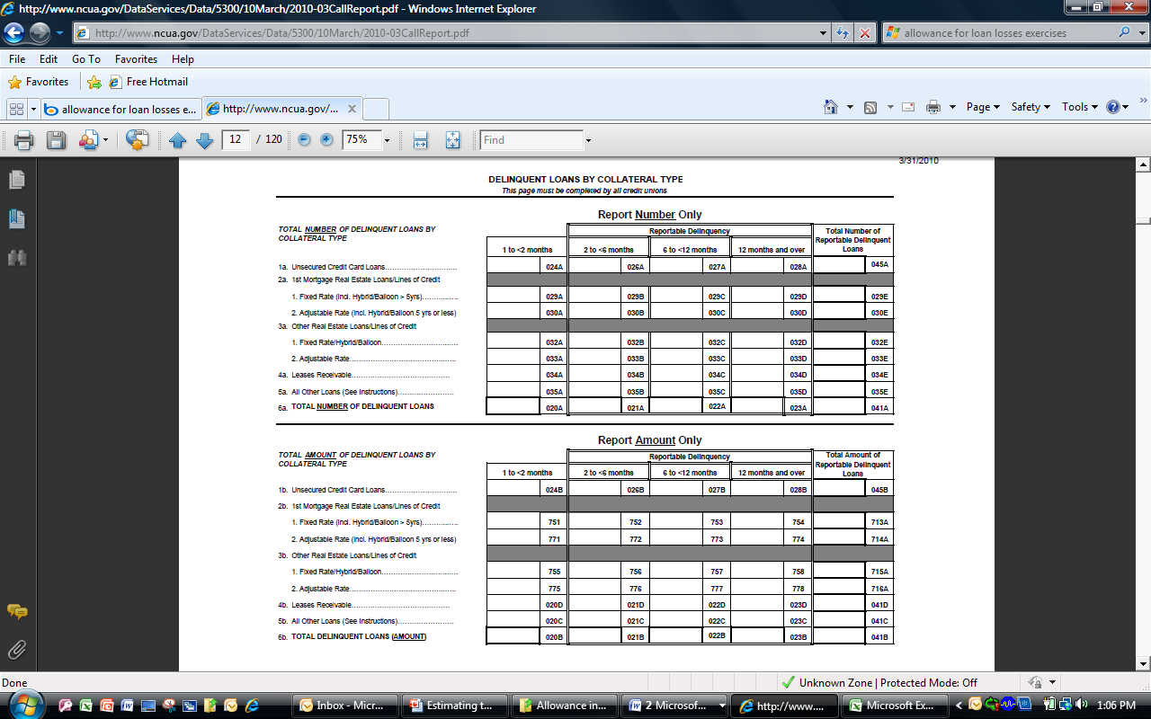

Slide 37
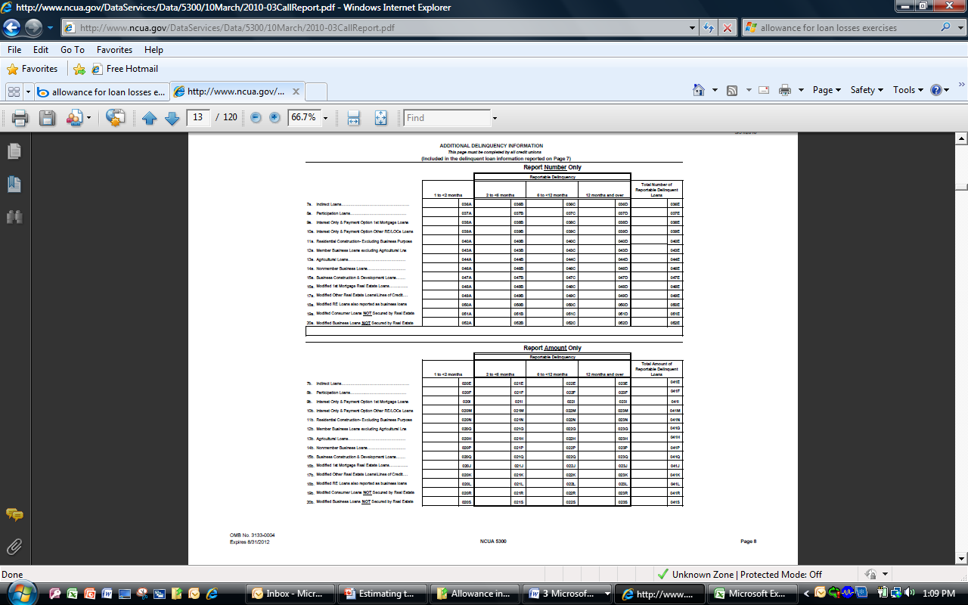

Slide 38
Key Points Summary
Credit unions should follow Supervisory guidance consistent with GAAP
Maintain documentation!
Management is responsible
Independent review (validation)
Pooling and Individual Impairment Analyses (FAS 5 &114)
Review for environmental factors
Notes:
Maintain documentation of methodology, and periodic assessments.

Slide 39
FAS 5
FAS 114
Pool loans
Analyze individual loans
Develop loss factor
Fair value, cash flow, market price
Apply to loan pools
Estimated ALLL

Slide 40
Questions

